Slide 1
Labradoodle or Fried Chicken?
Group 12
Han Cui, Jiwen You, Jingjing Feng, Yaqing Xie, Kanghui Jiang

Slide 2
SIFT + GBM
Feature: 2000*5000 SIFT data set
Model: Gradient Boosting Machine
Default Parameter Setting:
Interaction.depth <- 6
N.trees <- 1000
Shrinkage <- 0.01
Running time (1600 training data): 10 mins
Accuracy (400 testing data): 72.3%

Slide 3
SIFT + Feature Selection + GBM
Feature Selection Methods:
Set Variance Cut off Value: remove the features with low variance
Principle Component Analysis
Random Forest
Method | Selection Criteria | Selected Features | Running Time (1600 training data) | Accuracy (400 testing data)
Set Variance Cut Off Value | Drop the features with variance less than 0.5e-6 | 1968 | 4 mins | 71.3%
PCA | Keep 90% of the total variance | Roughly 750 | 2 mins | 72%
Random Forest | Select features based on their importance (13mins) | 750 | 1.5 mins | 64.5%

Slide 4
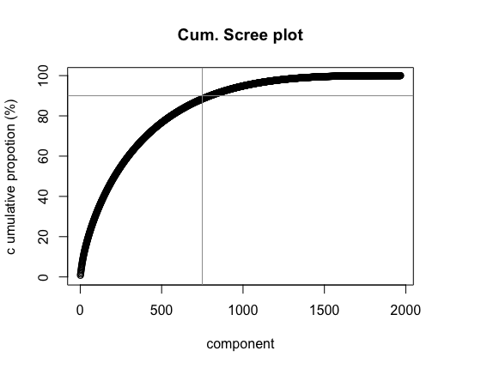

Slide 5
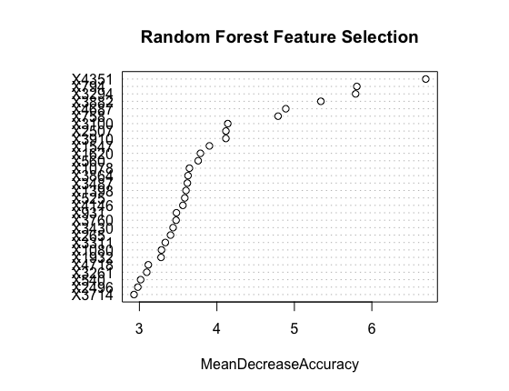

Slide 6
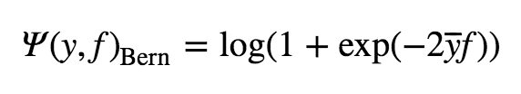

Gradient Boosting Machine
Loss function for categorical response
Bernoulli loss function
Adaboost loss function
Base learners: Decision Tree
Shrinkage: The learning rate applied to each tree during the expansion
Interaction.depth: The maximum number of splits
N.trees: The number of iterations

Slide 7
SIFT + PCA + GBM (Bernoulli)
Tuning Parameters & 5 folds Cross Validation
Distribution: Bernoulli (logistic regression for 0-1 outcomes)
Shrinkage: (0.0001, 0.0005, 0.001, 0.01)
Interaction.depth: (3, 5, 7, 9)
N.trees: (500, 1000, 1500, 2000, 4000)
Shrinkage | Interaction.depth | N.trees | Combination | Training Time | Accuracy
0.01 | 3 | 4000 | 80 | 12 hours | 70.3%

Slide 8
SIFT + PCA + GBM (Adaboost)
Tuning Parameters & 5 folds Cross Validation
Distribution: "adaboost" (exponential loss for 0-1 outcomes)
Shrinkage: (0.0005, 0.001, 0.01, 0.05)
Interaction.depth: (3, 5, 7, 9)
N.trees: (500, 1000, 1500, 2000, 4000)
Shrinkage | Interaction.depth | N.trees | Combination | Training Time | Accuracy
0.05 | 7 | 1500 | 80 | 12 hours | 71.5%

Slide 9

SIFT + PCA + SVM
Tuning Parameters & 5 folds Cross Validation
Kernel: Gaussian radial basis function
Gamma: The parameter of a Gaussian Kernel
(0.0001, 0.001, 0.01)
Cost: Trade off misclassification of training examples against the decision surface
(0.01, 0.1, 1, 5, 10, 50, 100, 200, 500)
Gamma | Cost | Combination | Training Time | Accuracy
0.0001 | 200 | 27 | 8 hours | 69%
Notes:
A small gamma implies the class of this support vector will have influence on deciding the class of the vector x_i even if the distance between them is large. If gamma is large, then variance is small implying the support vector does not have wide-spread influence. Technically speaking, large gamma leads to high bias and low variance models, and vice-versa.
A low C makes the decision surface smooth, while a high C aims at classifying all training examples correctly by giving the model freedom to select more samples as support vectors.

Slide 10
SIFT + PCA +Logistic Regression
Logistic regression with Stochastic Gradient Descent (SGD) training
SGD: Efficient approach to discriminative learning of linear classifiers under convex loss functions such as SVM and logistic regression
5 folds Cross Validation
Running Time | Accuracy
20s | 65%

Slide 11
SIFT + PCA + Xgboost
Xgboost is short for eXtreme Gradient Boosting package
It is generally over 10 times faster than the classical gbm
Tuning Parameters & 5 folds Cross Validation
eta: learning rate
max_depth: maximum depth of a tree
max_delta_step: maximum delta value allowed for each tree’s estimation
subsample: subsample of the training dataset
sclae_pos_weight: control for positive and negative weights
min_child_weight: minimum number of cases in each node
eta | max_ depth | max_delta _step | subsample | sclae_pos _weight | min_child _weight | Combination | Training time | Accuracy
0.01 | 8 | 1 | 0.8 | 1 | 6 | 480 | 6 hours | 71.3%

Slide 12
Base Model
Model | Training Time (5 folds CV) | Parameter Combination | Accuracy
GBM (Bernoulli) | 12 hours | 80 | 70.3%
GBM (Ada boost) | 12 hours | 80 | 71.5%
Support Vector Machine | 8 hours | 27 | 69%
Logistic Regression | 20s (no cross validation) | 0 | 65%
Xgboost | 6 hours | 480 | 71.3%

Slide 13
Advanced Model – Feature Extraction
Method: Convolutional Neural Network
Python Package: nolearn, lasagne, caffe
Nolearn & Lasagne
CNN structure: conv1 + pooling1 + conv2 + pooling2 + dropout1 + dense + dropout2
Feature Extracted: conv2, polling2
Result: Long feature extraction time
Caffe:
Layer structure: norm + conv + pool + fc + prod

Slide 14
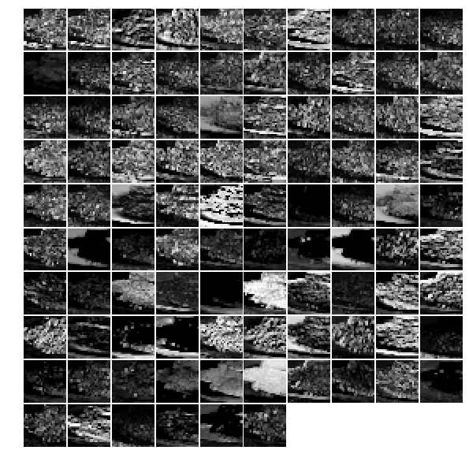
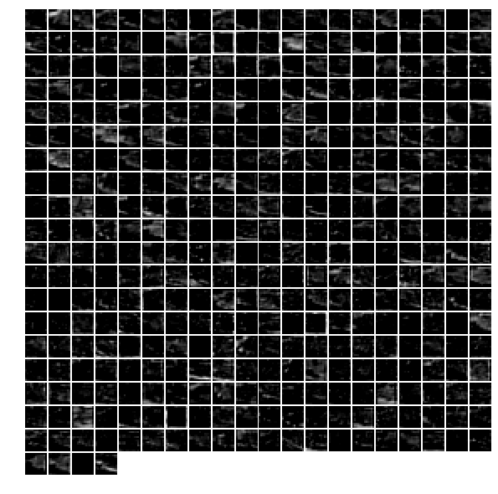
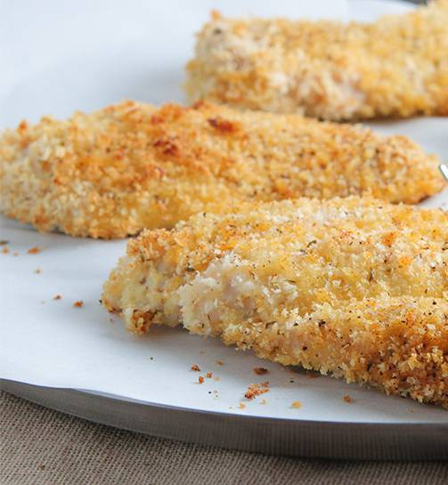
Advanced Model – Feature Extraction
Norm1 layer
Conv3 layer
Caffe Feature Extraction

Slide 15
Advanced Model
Layer (around 10mins) | Total Features | Features Selected | PCA: Total variance of Explanation | Logistic Regression Testing Accuracy (5 Folds CV)
norm1 | 69984 | 1200 | 91% | 85.75%
norm2 | 43264 | 1200 | 91% | 90.00%
conv3 | 64896 | 1200 | 90% | 91.75%
conv4 | 64896 | 1200 | 90% | 93.50%
conv5 | 9216 | 1500 | 94% | 93.25%
pool5 | 43264 | 1000 | 91% | 95.00%
fc6 | 4096 | 900 | 91% | 95.25%
fc7 | 4096 | 1000 | 96% | 96.50%
fc8 | 1000 | 1000 | 100% | 95.50%
prob | 1000 | 1000 | 100% | 93.00%
Layer (around 10mins) | Total Features | Features Selected | PCA: Total variance of Explanation
norm1 | 69984 | 1200 | 91%
norm2 | 43264 | 1200 | 91%
conv3 | 64896 | 1200 | 90%
conv4 | 64896 | 1200 | 90%
conv5 | 9216 | 1500 | 94%
pool5 | 43264 | 1000 | 91%
fc6 | 4096 | 900 | 91%
fc7 | 4096 | 1000 | 96%
fc8 | 1000 | 1000 | 100%
prob | 1000 | 1000 | 100%
Layer (around 10mins) | Total Features | Features Selected | PCA: Total variance of Explanation | Logistic Regression Testing Accuracy (5 Folds CV)
norm1 | 69984 | 1200 | 91% | 85.75%
norm2 | 43264 | 1200 | 91% | 90.00%
conv3 | 64896 | 1200 | 90% | 91.75%
conv4 | 64896 | 1200 | 90% | 93.50%
conv5 | 9216 | 1500 | 94% | 93.25%
pool5 | 43264 | 1000 | 91% | 95.00%
fc6 | 4096 | 900 | 91% | 95.25%
fc7 | 4096 | 1000 | 96% | 96.50%
fc8 | 1000 | 1000 | 100% | 95.50%
prob | 1000 | 1000 | 100% | 93.00%
Notes:
Time consideration
Logistic regression model is widely used in deep learning

Slide 16
Model Testing
Caffe + PCA + Xgboost:
9 hours training
95% accuracy
Scraping 2000 pictures from the internet
Advanced model: Caffe + PCA + Logistic Regression
Layer | Testing Accuracy | Layer | Testing Accuracy
Norm1 | 92.00% | Pool5 | 97.05%
Norm2 | 94.20% | Fc6 | 96.75%
Conv3 | 95.00% | Fc7 | 97.25%
Conv4 | 96.00% | Fc8 | 97.30%
Conv5 | 96.20% | Prob | 95.30%

Slide 17
Summary
Base Model：SIFT + PCA + Xgboost
Training time: 6 hours
Accuracy: 71.3%
Advanced Model：Caffe + PCA + Logistic Regression
Feature Extraction + training time: 12 mins
Accuracy: 96.5%

